Slide 1
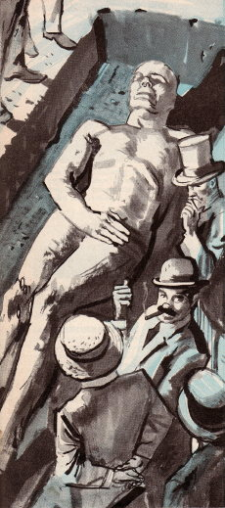
Cardiff Giant
Text and images reproduced from Popular Science, July 1959: The Giant That Fooled the World

Slide 2
George Hull
When George Hull left his weed-choked, debt-ridden tobacco farm outside Binghamton, N.Y., and headed west in 1868 to seek better fortune, he thought maybe he'd go prospecting for gold. But he never reached gold country. On the way, 90 years ago, he stumbled on something more precious than the yellow metal: human gullibility.

Slide 3
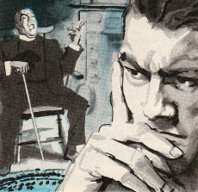
The Idea
IDEA. Wandering west to seek his fortune, George Hull stopped at Ackley, Iowa, to visit his sister. One night a clergyman dropped in, talked about giants who once strode the earth. Hull argued there were no such giants, then fell silent. The Big Idea had hit him. People would believe anything, he thought...

Slide 4
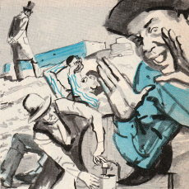
Raw Material
Hull had heard of petrified trees. Why not a petrified man -- a giant, aged to stone in his tomb? Near an Iowa railroad construction site, he found beds of gypsum, a soft limy rock. He paid a grading crew one keg of beer to quarry out a mammoth 12-by-4-by-2-foot block.

Slide 5
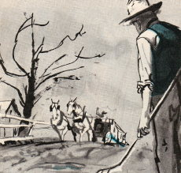
Transport
The block weighed some three tons. Hull had it wrapped in canvas and hoisted onto a dray. It took three weeks to move it 40 miles to the nearest railhead. Two wagons and a bridge broke under the weight. Hull cut off a ton, told bystanders the stone was for a monument.

Slide 6
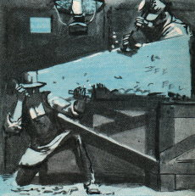
Sculpture
Hull confided his scheme to Chicago stonecutter Ed­ward Burkhardt, had the block hauled into an empty barn Burkhardt owned. With two assistants, Burkhardt began hacking the gypsum into the figure of a 12-foot-tall man who had died in agony. The face was a likeness of Hull's.

Slide 7
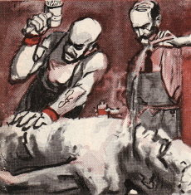
FINISHING TOUCHES
To simulate pores in the giant's skin, Hull made special hammers by setting needles in lead bases. To make him look antique, the stonecutters rubbed him with sand, water, ink, and sulfuric acid. By unexpected luck, veinlike lines appeared in the gyp­sum.

Slide 8
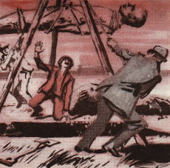
Setting the Bait
In Cardiff, N.Y., a relative of Hull's, William Newell, had a farm. For a fourth interest, he agreed to have the giant buried there. In November, 1868, Hull, Newell and two friends low­ered the 2990-pound colossus into his tomb, carefully filled it over.

Slide 9
SPRINGING THE TRAP
Hull waited a year until all talk of his mysterious wagon cargo was forgotten. Then, in October, 1869, Newell hired two neighbors to help him dig a well -- pointing out just where they should start. The point of a shovel hit something. The hoax was on.

Slide 10
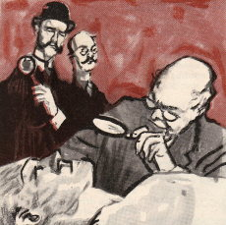
Last Hurdle
Hull’s one worry was that scientists would spot the hoax, but to his delight they were awestruck. They came from universities and museums far and wide. They didn’t go for the “petrified man,” but called the giant an ancient statue. Hull told Newell to bill it as such to the public.

Slide 11
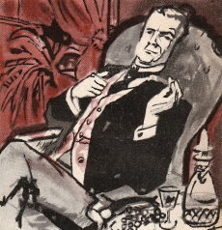
In the Money
Huge crowds came to see the giant. Newell fenced off the area, hired a barker, charged 50-cents admission. Hull refused one $10,000 offer for his “find,” finally sold a part interest to Syracuse businessmen for $30,000. The giant was exhibited in Boston and elsewhere.

Slide 12
Hoax Revealed
TROUBLE BEGINS. Showman Phineas T. Barnum of­fered a huge sum, reportedly over $50,000, for a share. Newell turned him down. Barnum then had his own giant made of papier-mache, exhibited it in New York, offered a $1,000 reward to anyone who proved his less genuine than Hull’s.
THE JIG IS UP. Stirred by Barnum’s spoof, scholars examined the giant more closely early in 1870. Prof. O.C. Marsh of Yale noticed crev­ices ink and sulfuric acid hadn’t reached, fresh tool marks near worn surfaces. The Iowa rail crew remembered quarrying the gypsum block for Hull.
THE END. Hull finally sold his giant to a carnival. He was a rich man. But by 1873 he was flat broke again, a result of bad investments. He tried to repeat his great hoax with another giant “discovered” in Colo­rado, but this second hoax never got off the ground. Hull went to England... and oblivion.

